Slide 1
Review Physical Properties of Minerals
Name the 5 ways scientists group physical properties of minerals
Hardness
Density
Lustre
Streak
Colour
Cleavage
Magnetism

Slide 2
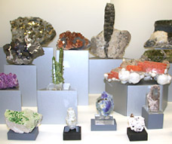
Minerals Review
All minerals must:
Occur naturally in nature
Inorganic solid
Crystal structure
Definite chemical composition
http://nature.ca/museum/press/2006/pr06-02-07_minstucson_e.cfm

Slide 3
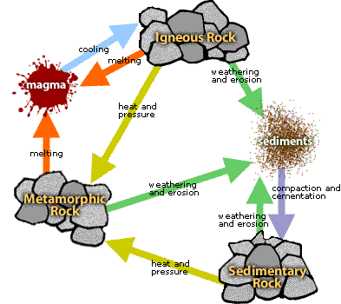

Slide 4
DO NOW
Explain the difference between a rock and a mineral and THEN
List 3 mineral properties and give an example of each.

Slide 5
I know what igneous rocks are and how they form
I know the difference between intrusive and extrusive rocks

Slide 6
Mineral
A naturally occurring solid substance with a definite chemical composition.
Notes:
Inorganic = not from living

Slide 7
Magma
Hot fluid or semi-fluid material below or within the Earth's crust
Notes:
Inorganic = not from living

Slide 8
Property
Property = characteristic
Characteristic = property

Slide 9
I know what igneous rocks are and how they form
I know the difference between intrusive and extrusive rocks
Making the connection
The properties of igneous rocks allow us to identify them, and understanding their properties helps us to figure out how they formed.
Rocks are made of minerals
All rocks are found in the lithosphere, which is the outside layer of the Earth
Property – Characteristic
Mineral - A naturally occurring solid substance with a definite chemical composition.

Slide 10
I know what igneous rocks are and how they form
I know the difference between intrusive and extrusive rocks
What is are igneous rocks?
Igneous rocks are formed from the crystallisation of magma at or below the Earth’s surface.
Memory aid
Igneous (Latin ig = fire, neous = born) rocks are formed from molten magma.
Use the memory aid to remember how Igneous Rocks form

Slide 11
I know what igneous rocks are and how they form
I know the difference between intrusive and extrusive rocks
What are the main characteristics of igneous rocks?
There are three main characteristics of igneous rocks:
Interlocking crystals
Generally lack layering
No fossils
They also often contain quartz, mica (muscovite and/or biotite), feldspar, amphiboles, pyroxenes and olivine.

Slide 12
I know what igneous rocks are and how they form
I know the difference between intrusive and extrusive rocks
What determines how an igneous rock looks?
The way that igneous rocks look depends on two things:
How fast the magma/lava cools
Which minerals it is made of

Slide 13
I know what igneous rocks are and how they form
I know the difference between intrusive and extrusive rocks
What are the two main types of igneous rocks?
Igneous rocks that are rich in silica (quartz) are described as felsic. They tend to be light in colour
Igneous rocks that are silica poor are described as mafic. They tend to be dark in colour.

Slide 14
Extrusive – rocks that form when magma reaches the surface (result: small crystals)
Intrusive – rocks that crystalise below the earths surface (results: large crystals)
Extrusive or intrusive - Crystal size
The size of the crystals in a rock can tell us its history.
Rocks which have been extruded from a volcano will cool rapidly and the crystals will be microscopic.
Intrusive rocks solidify beneath the Earth’s surface over geologically long periods of time resulting in large crystals.

Slide 15
I know what igneous rocks are and how they form
I know the difference between intrusive and extrusive rocks
If magma cools slowly, what size do we expect the crystals to be?
If the magma cools quickly, there isn’t enough time for large crystals to grow, so igneous rocks that cool quickly have small crystals.

Slide 16
I know what igneous rocks are and how they form
I know the difference between intrusive and extrusive rocks
What are the two main types of igneous rocks?
There are two main types of igneous:
Intrusive – cool below the surface
Extrusive – cool at the surface

Slide 17
I know what igneous rocks are and how they form
I know the difference between intrusive and extrusive rocks
Why is learning about igneous rocks important?
Rocks tell a story – the type of rock tells you what the rock has been through and allows us to draw conclusions about how they formed.

Slide 18
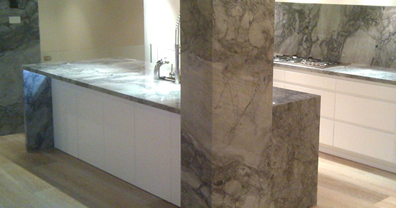
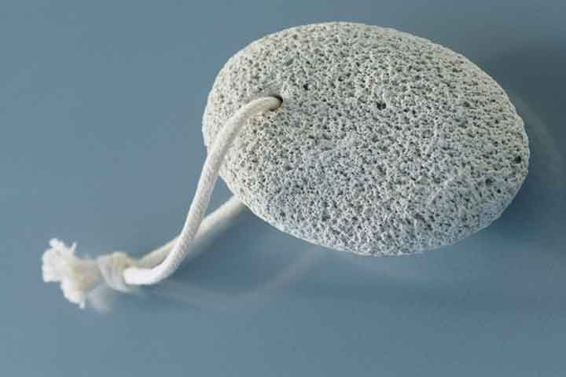
Here are some uses of igneous rocks:
Granite has strong properties, it is used for
Building and construction because of.
Head stones and kitchen counter tops.
Pumice is lightweight and has lots of air spaces, it is used
by cosmetic and cleaning industries to make things like excess skin removing stones
in some toothpaste products because of its abrasive nature.

Slide 19
I know what igneous rocks are and how they form
I know the difference between intrusive and extrusive rocks

